Slide 1
Development Of Curriculum in Mathematics
By Dr. Meena Sharma

Slide 3
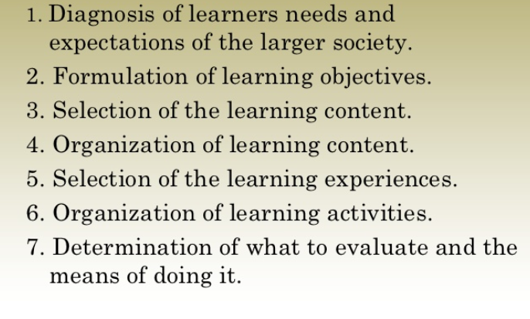
Steps of Curriculum Development
Details

Slide 4
Diagnosis

Slide 5
Selection of Aims and Objectives

Slide 6
Suggesting Appropriate Learning Experiences

Slide 7
Suggesting Appropriate Learning Experiences

